Slide 1

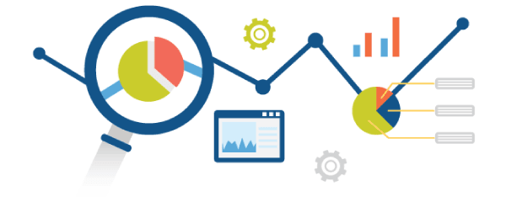


Predictive Analysis using Python🐍
Guido Van Rossum

Slide 2




PRAMOD VISHNU NAIK
Current Position: Software Development Engineer (Full-Stack, MERN stack and Gen AI Developer), MResult Technologies Pvt Ltd.
Educational Qualification: MCA (Specialization in Data Science and Cloud Computing), Srinivas University, Mangalore Certifications: AWS Certified Professional
Experience:
3.5 years of professional experience in software development
Assistant Professor (Guest Lecture and Mentor) with 2 years of teaching experience.
Skills:
Primary Skills: AWS, ML, Node.js, React, Redux Toolkit, TypeScript, Express.js, Python, FastAPI, Flask, SQL, PostgreSQL, MySQL, Java, PHP, DataIKU, Snowflake, Informatica IICS.
PRAMOD NAIK
Address: Mangalore, Karnataka.
+91 9611025113
pramodnaik.dev@gmail.com

Slide 3

Problem Statement:
What will we accomplish in this workshop?

Slide 4
Predictive Analysis:
Predictive Analysis (or Predictive Analytics) is the process of using historical data + statistical models + machine learning to predict future outcomes.
It doesn’t just tell you what happened in the past (descriptive) but also what is likely to happen in the future.
Example:
Predicting Next Year’s College Admissions
Retail Sales Forecasting
Weather Prediction
Student Exam Performance

Slide 5
Python libraries for Predictive Analysis
Library | Use Case
Pandas | Data manipulation & preprocessing
NumPy | Numerical computing foundation.
Matplotlib & Seaborn | Data visualization.
Scikit-learn (sklearn) | Machine learning & predictive modeling
SciPy | Scientific computing
TensorFlow & Keras | Deep learning frameworks

Slide 6


Slide 7
🐼 Pandas in Python for Data Analysis?
Pandas is a powerful and popular open-source Python library used for data manipulation, analysis, and cleaning. It provides easy-to-use data structures and functions to work with structured (tabular) data efficiently.
Pandas = Panel Data → used for handling structured data (tabular form).
Built on top of NumPy → optimized for fast operations.
Why Pandas?
It simplifies data analysis tasks.
Makes large data easy to understand and manipulate.
Built on top of NumPy, so it's very fast.

Slide 8


Slide 9
NumPy : TheNumPy NumPy (Numerical Python) is a powerful library in Python used for numerical computing. It provides support for large, multi-dimensional arrays and matrices, along with a collection of mathematical functions to operate on these arrays efficiently.
Why Use NumPy?
Faster than Python lists: NumPy arrays are more efficient than Python lists due to optimized memory and vectorized operations.
Supports Multi-dimensional Arrays: Easily handles 1D, 2D, and ND arrays.
Rich Mathematical Functions: Offers functions like mean, median, standard deviation, linear algebra, etc.
Integration with Libraries: Used in Pandas, Matplotlib, Scikit-Learn, TensorFlow, etc.

Slide 10
Role of Pandas and NumPy in Predictive Analytics
Predictive Analytics = Data Preparation + Modeling + Prediction + Evaluation
Pandas and NumPy sit in the data preparation & mathematical foundation stages.

Slide 11
1. Role of Pandas
Pandas provides the data manipulation & analysis layer:
Read & clean data (CSV, Excel, SQL, JSON).
Handle missing values, duplicates, outliers.
Perform feature engineering (create new predictive variables).
Handle time-series data (resampling, rolling averages).
Integrates smoothly with NumPy and ML libraries (Scikit-learn, TensorFlow).
👉 Pandas is like the data wrangler, NumPy is the math engine.

Slide 12
2. Role of NumPy
NumPy provides the mathematical foundation for predictive analytics:
Efficient handling of numerical arrays & matrices.
Performs vectorized computations (fast calculations).
Implements linear algebra (matrix multiplication, inversion, eigenvalues) — essential for regression, PCA, neural networks.
Random number generation for simulations & ML model initialization.
👉 Without NumPy, ML algorithms (like linear regression, logistic regression, neural nets) would be very slow in pure Python.

Slide 13

Hands-On

Slide 14

Follow the ReadMe.md File in GitHub…

